Slide 1
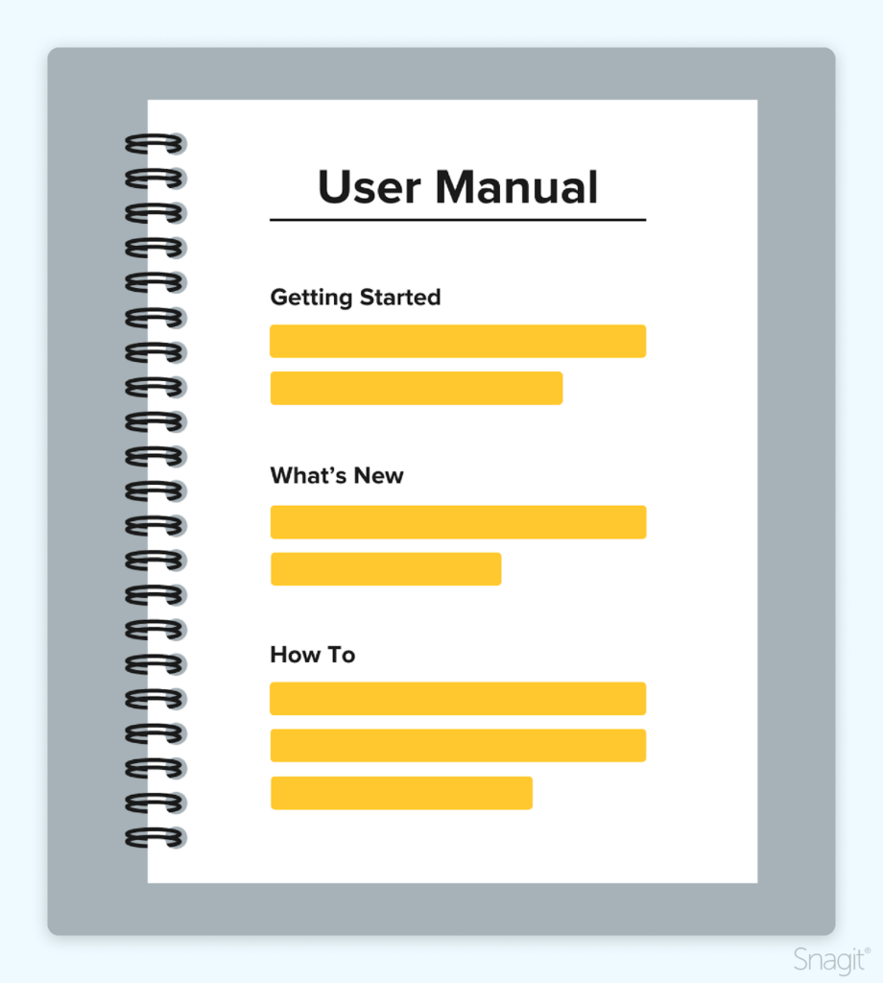
PULOAR :
A NEXUS OF OPEN RESOURCES
PRESIDENCY UNIVERSITY LIBRARY OPEN ACCESS RESOURCES
USER MANUAL

Slide 2
PULOAR – HOME PAGE

Slide 3
PULOAR – HOME PAGE
Click here for PU subscribed online databases
Click here for the PU
Library OPAC
Click here for the PU digital library

Slide 4
PULOAR – ABOUT OPEN ACCESS
About OA
Budapest Open Access Initiative
Meaning & Advantage of OA
IFLA Statement on Open Access
Creative Commons
Click here to know more about open access

Slide 5
PULOAR – SEARCH FOR OPEN ACCESS RESOURCES
Author
Article
Journal Title
More Action
PUOAs

Slide 6
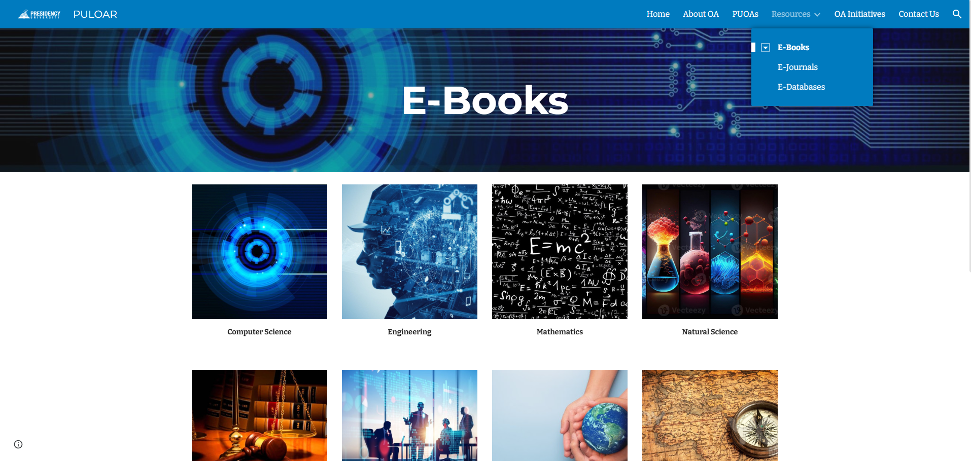
PULOAR – E-RESOURCES
Resources

Slide 7
PULOAR – E-RESOURCES
E-Journals

Slide 8
PULOAR – E-RESOURCES
E-Databases

Slide 9
PULOAR – OPEN ACCESS INITIATIVES
OA Initiatives
Hathi Trust
Project Gutenberg
NDL India
E-Books Directory
e-PG Pathshala
Internet Archive
Open Textbook Library
Shodhganga
Free Management eBooks
ArXiv.org

